Slide 1
This is Chemistry 3A
If you are not enrolled or waitlisted, see your counselor
All others will sign in with Attendance Code during this first day in lecture
Seats are available first to enrolled students
Waitlisted students will have to stand or find useful floor space for sitting if no available seating

Slide 2
Chemistry 3A
Introductory General Chemistry
Course Administration & Policies
S. M. Halloran

Slide 3
Course Facts & Information
Know your section number
There are 30 enrolled students in each section
Both sections, 60 students total, will be here in room NS-101 (yes, here) from 5:00-6:20 p.m. on Tuesday and Thursday
Right after lecture, one section will have its lab sessin in room NS-339 starting at 6:30 pm

Slide 4
Waitlisted Procedure
Only students on waitlist have a chance of being added to course
Enrolled students who are no-shows in 1st lecture get 24 hours to make contact with instructor if they wish to continue enrollment
Waitlisted students attending 1st lecture & submitting Attendance Code will be given Add Authorization IF slots become available and in order of the queue of intent-to-enroll on waitlist. A message will be sent to add the course
  Students on waitlist given Add Authorization have 24 hours to add the course, or the Add Authorization is removed & given to next student on waitlist
The last day a waitlisted student is able to add is the 1st day of the 3rd week of semester

Slide 5
Your Instructor
Mitch Halloran
“Mitch”
“Mister M”, “Mister H”, “Mister Mitch”
“Dr. H”, “Dr. Mitch”, “Dr. M”
Probably not
“Professor Halloran” (but thank you)
“Mitchell” (certainly not! Not even Mom called me that except in a fit)

Slide 6
The Project
To see you realize the objectives of the Chemistry 3A course in the Department of Chemistry at Fresno City College
In 18 weeks
Through implementation of the course design already developed

Slide 7
Communication Plan
All projects—like your success in this course—write out a communication plan
This is about what and how to communicate to move the project along
What to communicate
  Asking about how to solve a problem, understanding details of an assignment, when is a deadline
  Helping each other with reminders, setting up an interactive meeting online or in person
How to communicate
  Canvas Inbox/Messages
    Avoid “reply”ing to Canvas Announcements, Assignments, etc. Might not be seen
  Email: mitch.halloran@fresnocitycollege.edu
  Zoom: “online office hours” (MORE TO FOLLOW)

Slide 8
Working Successfully in Chem 3A
Syllabus
  Answers questions about objectives, content, structure of the course with a broad overview and outline of the course
  Information about required materials for the course
  freely accessible online textbook
  lab gear (coat + goggles)
  scientific-grade calculator for use on examinations
  Grading: components of performance in course
    Examinations: midterms and final
    Reports of laboratory experiments submitted
    Homework: pre-lecture and pre-lab quizzes, graded assignments, ungraded offerings (practice exams)
  Policy on late work submission, missed exams (retakes), etc

Slide 9
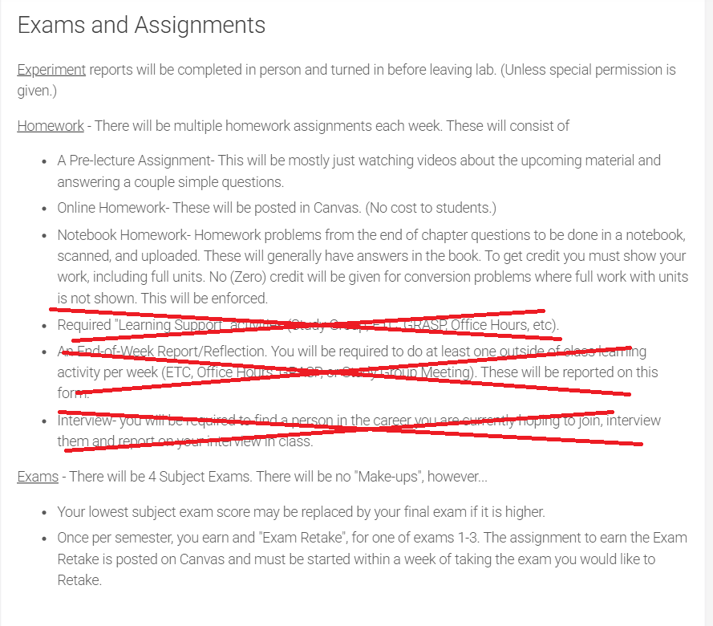
SYLLABUS CHANGES
  I will be making changes to the syllabus and putting them up hopefully before Thursday’s (Aug 14) lecture
  The last three list items under “Homework” will not be utilized in this course

Slide 10
Working Successfully in Chem 3A
Online Systems/Tools
Canvas
  Modules – each week a module will be published and you should find your links to what you need to do to doing reading, complete quizzes, find homework
  Announcements – look for this regularly
  Course Home Page
Interaction between instructor & student(s)
  Part-time instructors interact through Canvas and email
Email: Mitch.Halloran@fresnocitycollege.edu

Slide 11
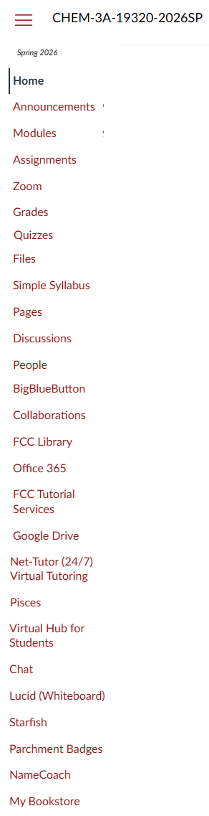
Canvas Features
  Modules your main go-to
  Announcements important
  Grades!
  Zoom – your walk-in “office hours”
  Starfish – helps instructor contact with those who can help you deal with college
  Conference : BigBlueButton – works like Zoom?
  NameCoach: help me & others pronounce your name
  Chat – can be a thing
  Lucid – need to work with that

Slide 12
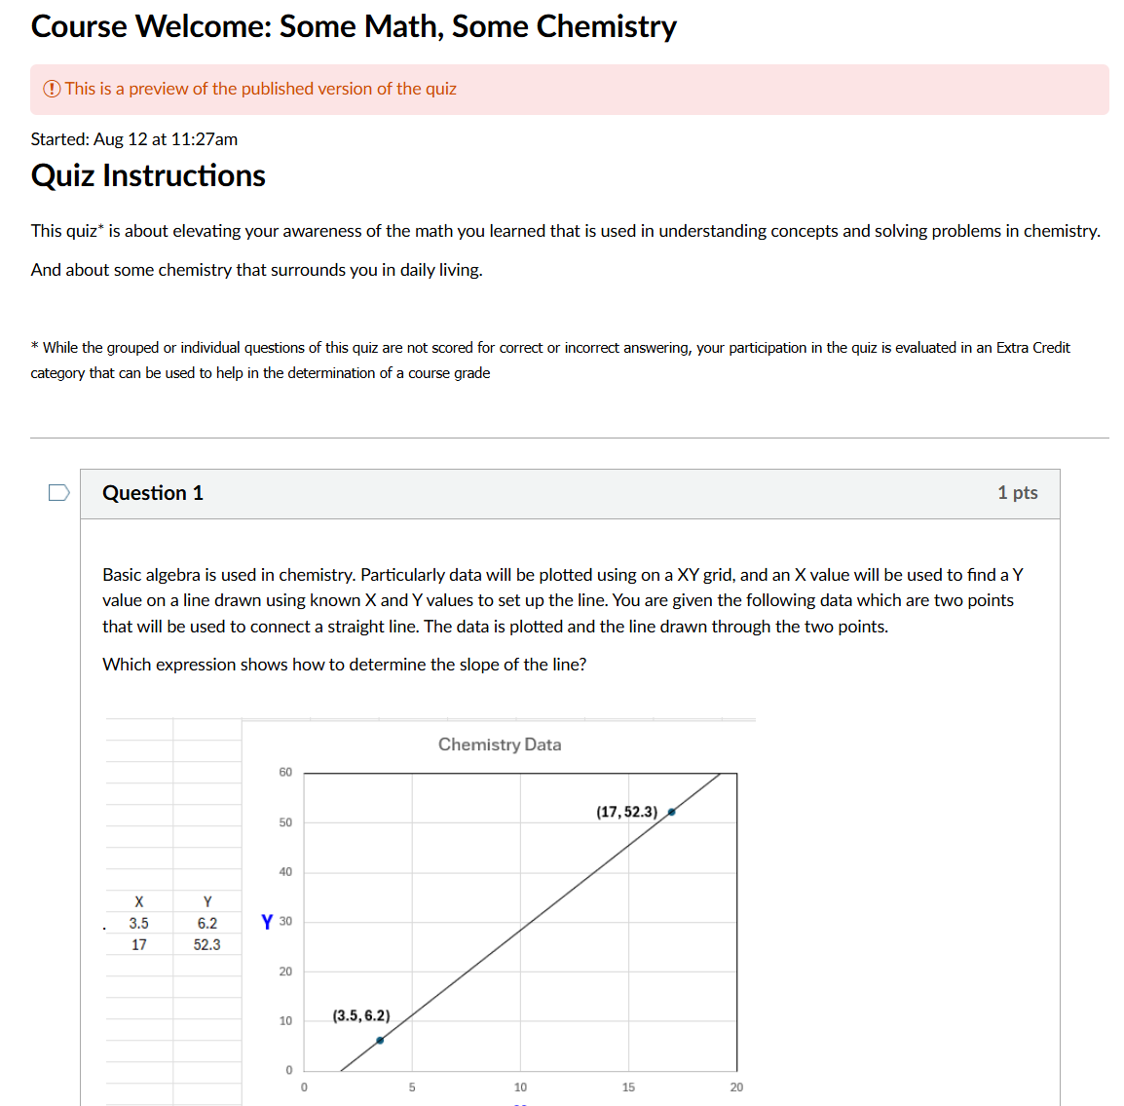
Content on Canvas app Now
  There is content on the Canvas app now
  Check Assignments
  typically
  It can also link to Quizzes

Slide 13
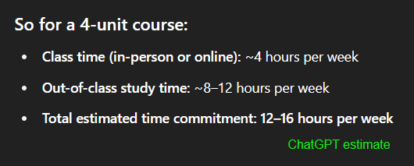
Working Successfully in Chem 3A
Attendance
  Being at lecture & certainly being in the lab is not optional: attendance is recorded
  While attendance is not graded, missing lectures can result in being dropped from course, getting messages from instructor
  Missed laboratory sessions get a ZERO for required report of that experiment
Time Commitment

Slide 14
Rubrics
A rubric is a structured scoring guide that defines the criteria, performance levels, and expectations used to evaluate the quality of a student’s work
It clarifies what matters, how it will be judged, and what distinguishes stronger from weaker performance.
Rubrics in Canvas are to be used for
  laboratory report submissions
  homework
Students should look at the rubric so they can see what is expected of them in the submission of work, and BEFORE the work is submitted

Slide 15
Content For This Course
All of the content of this course, including the PowerPoints of these lectures (in PDF form), should be found in some place on the Canvas app
And if you don’t find what you are looking for, send me a message right away

Slide 16
Teamwork
Throughout your career, you will learn that projects and programs have teams of people in order to get work done successfully.
While tasks in projects are done by individuals performing roles as part of the team, the overall work is a product of the team
The “project” here at FCC in this course is learning chemistry, so everyone will be part of a team
This team is your study group

Slide 17
The Study Group
The Canvas LMS app was used to randomly group students into study groups in this course
The study group is only one facet of your learning process, intended to initiate you into being part of a team in your learning goal
Your instructor (me), your peers, resources of the College (tutors, tutoring services, counselors, other support staff) are always ready & present too

Slide 18
Artificial Intelligence in Learning & Academics
The elephant in the room? Have you been talking about it in your course of learning?
Will be transformative, but…
  useful to you IF you use it properly
  ChatGPT/Bing CoPilot/Gemini don’t initiate the “what if” and “why” that drives discovery and exploration
  A.I. does not and will not replace humans in asking questions that push discovery
  Learning the foundations of a discipline—that is, getting that Associates or Bachelors or Doctoral degree—makes you that better thinker who is asking “what if” and “why”
Doing that “homework”…
  Helps you pass the test, yes
  But also builds you as a discoverer, explorer, researcher, thinker

Slide 19
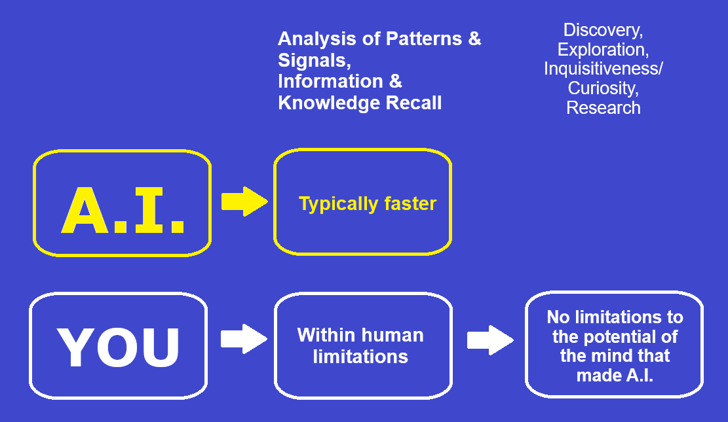
Artificial Intelligence in Learning & Academics
This is why you take
Chem 3A & learn chemistry:
to prepare you for doing what A.I. can’t [ever] do

Slide 20
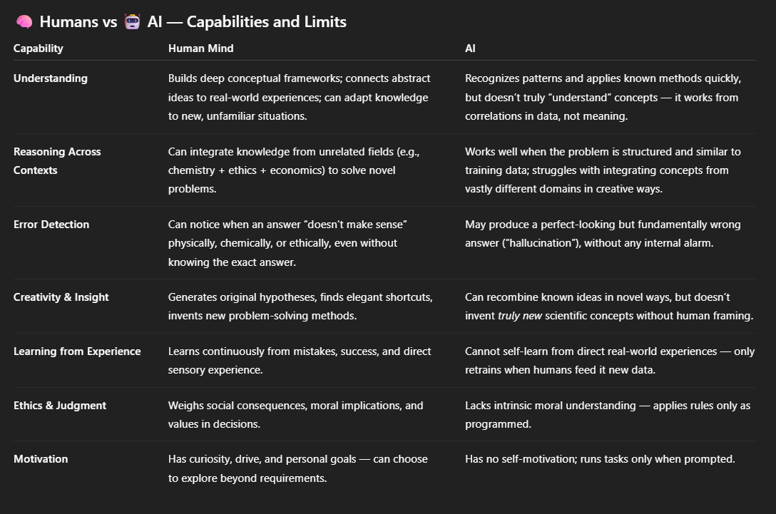
Artificial Intelligence in Learning & Academics

